Slide 1


Earth Observation and Information Technologies for Eradicating Hunger
Charles F. Hutchinson
University of Arizona
Federation of Earth Science Information Partners

Slide 2
Premise
Better agricultural information can help eradicate hunger by:
  Allowing global markets to function efficiently
  Providing producers with the information they need to make decisions
  Anticipating humanitarian emergencies quickly so that they can be effectively addressed
Better is defined as more:
  Timely
  Accurate
  Broadly available

Slide 3
Objectives
Review the evolution of agriculture and food security monitoring
Outline the contribution of satellite Earth observations to agriculture and food security monitoring
Identify current and future challenges in meeting information requirements that confront the MDG
Consider what GEO is contributing to address those challenges

Slide 4
The Need for
Crop Production Estimates
Crop failure in Soviet Union led to the “Great Grain Robbery” (1972)
NASA, USDA, and NOAA developed methods to monitor global crop production based on new Earth observing capability (Landsat)
  Large Area Crop Inventory Experiment (LACIE, 1974)
  Agriculture and Resources Inventory Through Aerospace Remote Sensing (AgRISTARS, 1978)
Formed the basis for techniques now used by USDA Foreign Agriculture Service, and National Agricultural Statistical Service

Slide 5
The Problem
Estimates are conceptually simple
Production = Planted Area x Yield
Planted area can be estimated from Landsat
  Crop type cannot always be identified remotely
  Fields may be small and/or intercropped in developing countries
Yield can be monitored through ground sampling throughout the growing season
  Ground sampling expensive and often impossible
Worked reasonably well in developed countries

Slide 6
The Need for
Monitoring Food Security
African drought and famine in 1960s and 1970s highlighted the global community’s inability to anticipate food emergencies
Widespread famine in Africa in 1984 led to use of AVHRR time-series data to monitor the quality of growing season
  USAID Famine Early Warning System (FEWS, 1985)

Slide 7
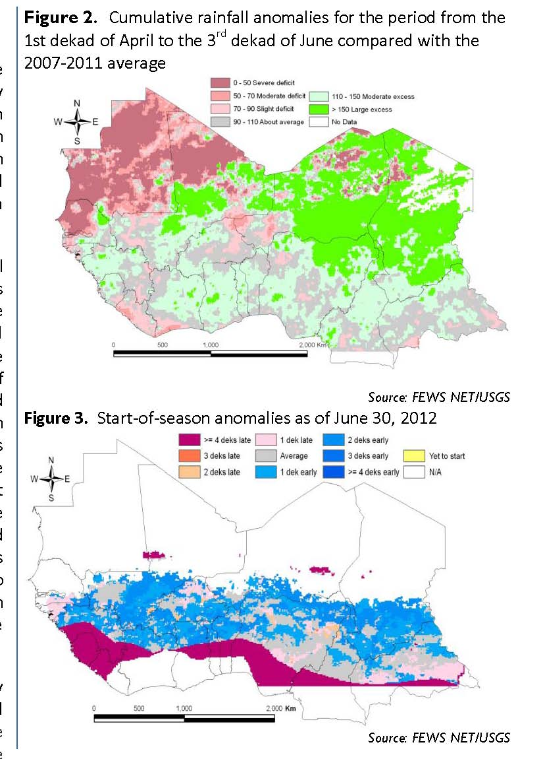
Quality of Season
AVHRR time-series data allowed for monitoring the quality of the growing season as it evolved
  Augmented rainfall measurement
  Complemented crop water requirement models
  Provided global coverage
Became a key component of global agricultural monitoring

Slide 8
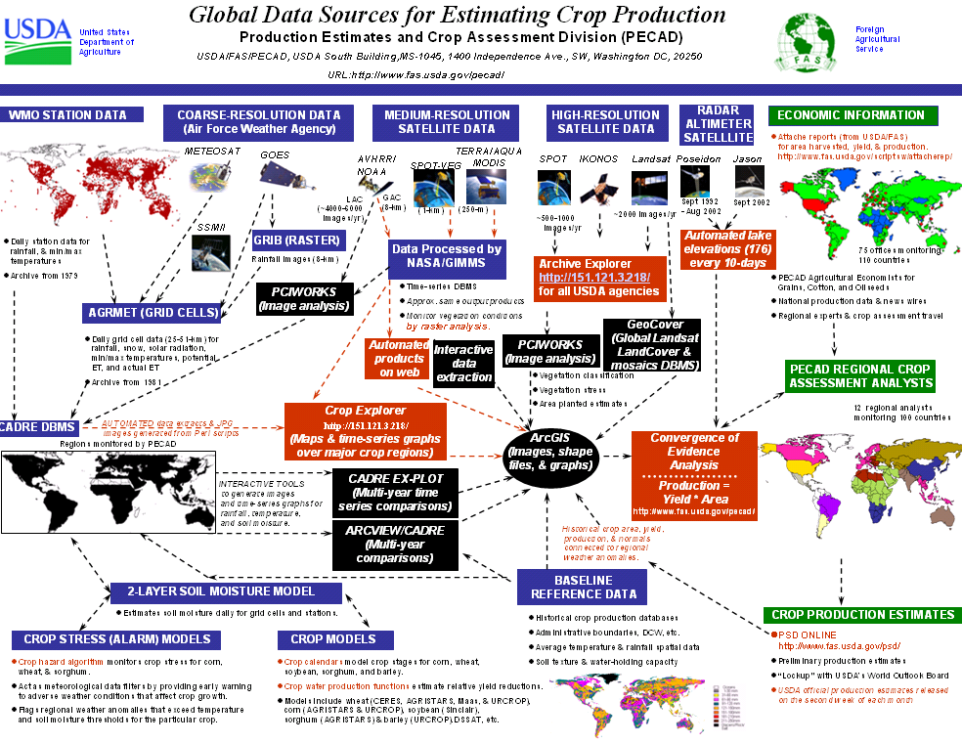
PECAD
Notes:
USDA’s idea of clearly explaining FAS DSS

Slide 9
The Problem of
Monitoring Human Responses
Populations vary in their ability to absorb the consequences of emergencies (crop failures, natural disasters, war).
  Vulnerability to emergencies are conditioned by the resources they command, their political position, their social connectivity, and their access to infrastructure (among other things)
  All affect their ability to access food, independent of its availability.

Slide 10
HOUSEHOLD RESPONSES TO ECONOMIC DISTURBANCE
Adaptation
Divestment
Liquid
Assets
Productive
Assets
Diet change
Famine food use
Loans from kin
Labor migration
Sale of small animals
Environment
threatened
Loans from merchants
Household Resources
Livelihoods
threatened
Sale of farm implements
Sale of draft animals
Lives
threatened
Farmland sale
Distress migration
Time

Slide 11
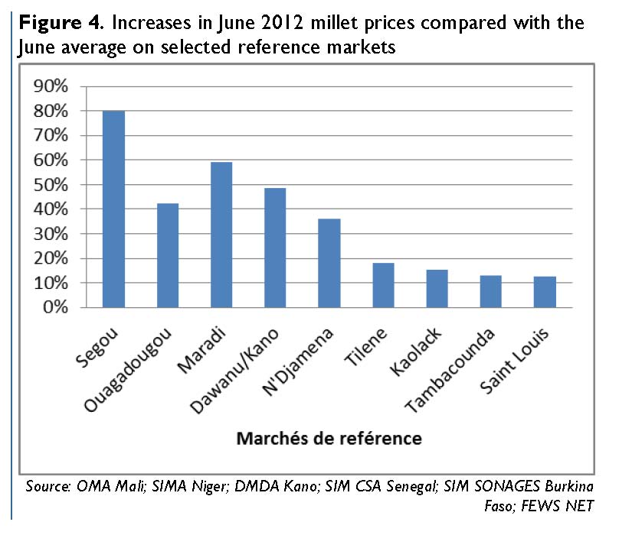
Impact Inference
The prices of cereal grains are sensitive to real and perceived scarcity
  Terms-of-trade are often used as well
Requires a great deal of effort to acquire routinely and accurately

Slide 12
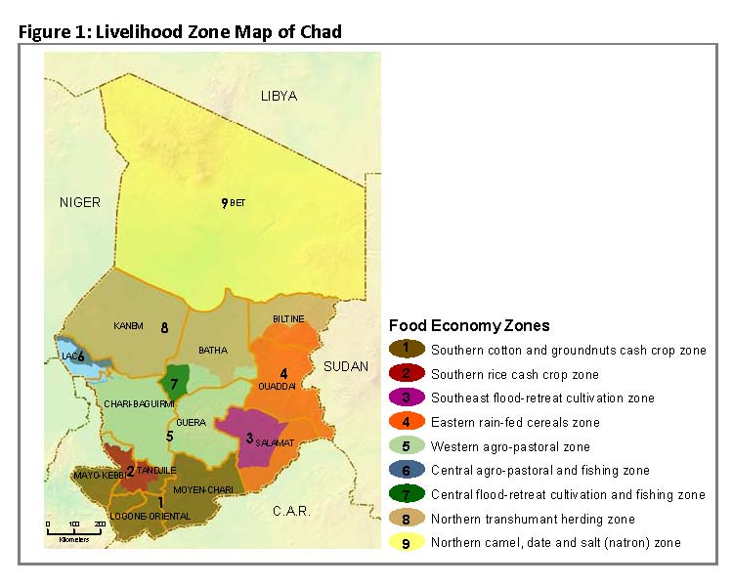
Context
Emergencies affect groups differentially according to their livelihoods
Livelihood zones stratify a country into regions that are relatively homogenous
The effect of an emergency can be more accurately inferred within these zones

Slide 13
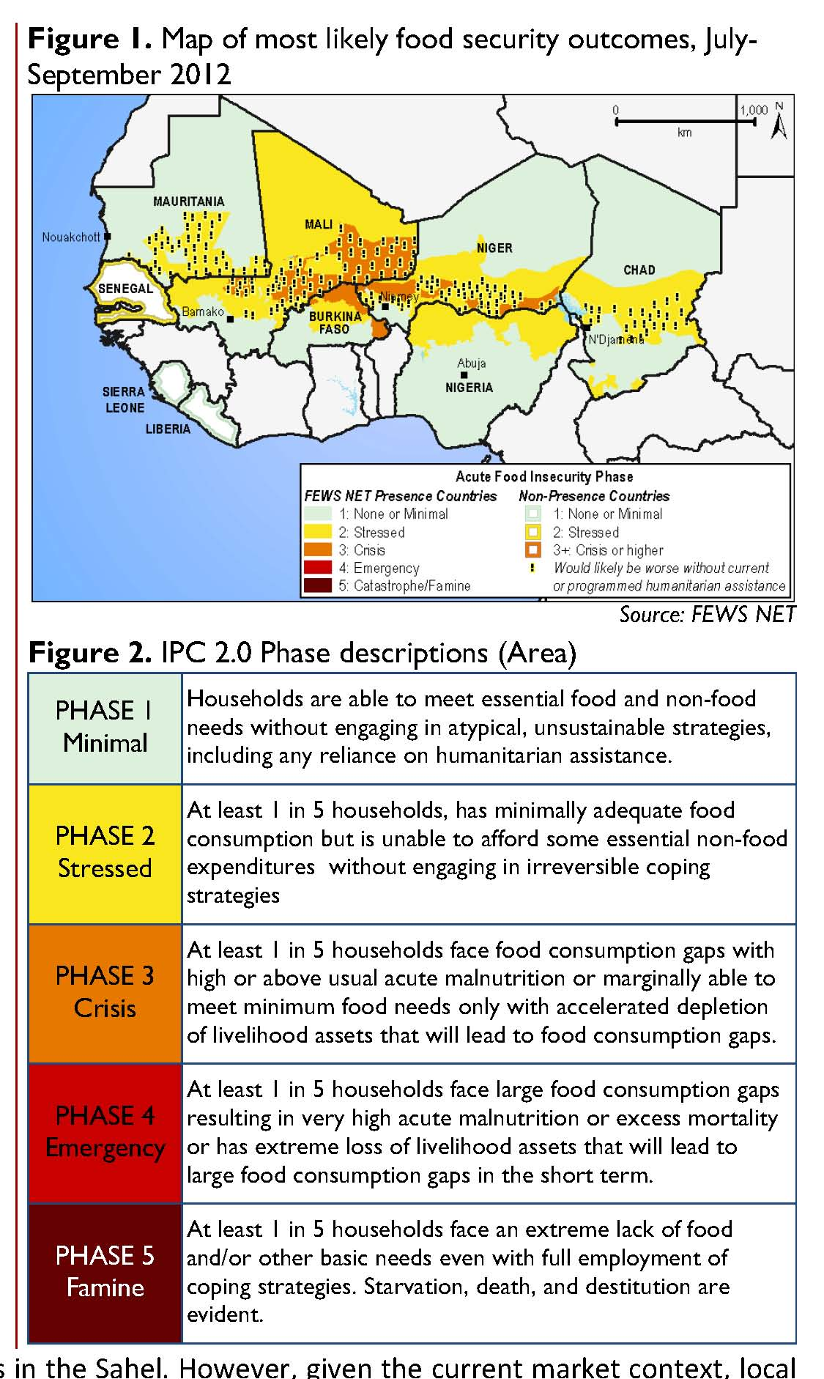
Reporting
Observations that suggest supply:
  Rainfall
  Remote sensing products
  Model outputs
  Reports from ministries of agriculture
  Field reports
  Other sources
Observations that suggest relative stress:
  Cereal prices/terms of trade
Interpreted within the context of Livelihood Zones
Reported in the Integrated Food Security Phase Classification (IPC)

Slide 14
Challenges:
New Satellite Data

Slide 15
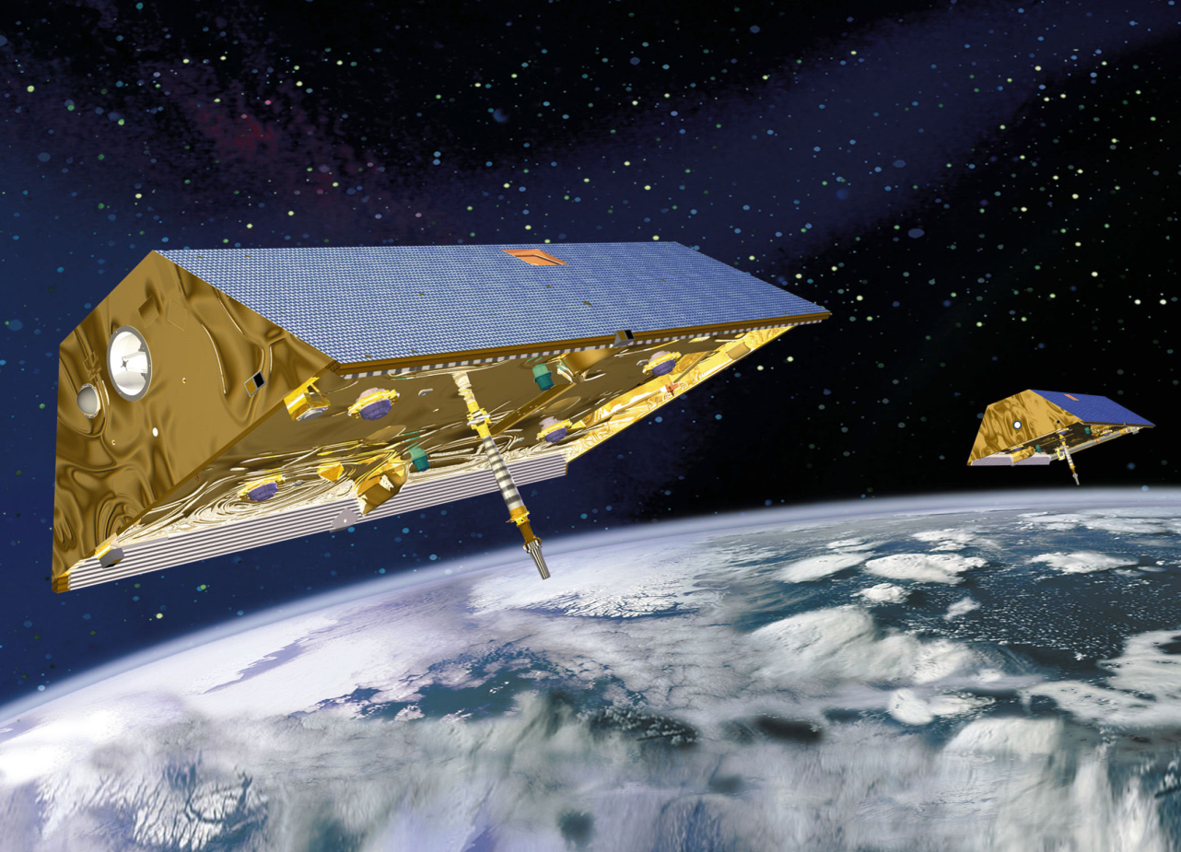
GRAVITY RECOVERY AND CLIMATE EXPERIMENT
GRACE a joint NASA- DLR mission
Two satellites fly in tandem
Measures variations in the effects of Earth’s mass on satellites using microwave ranging and GPS
In orbit since 2002, used to map gravity field and how it changes
http://grace.jpl.nasa.gov/
Notes:
On orbit since March 2002

Slide 16
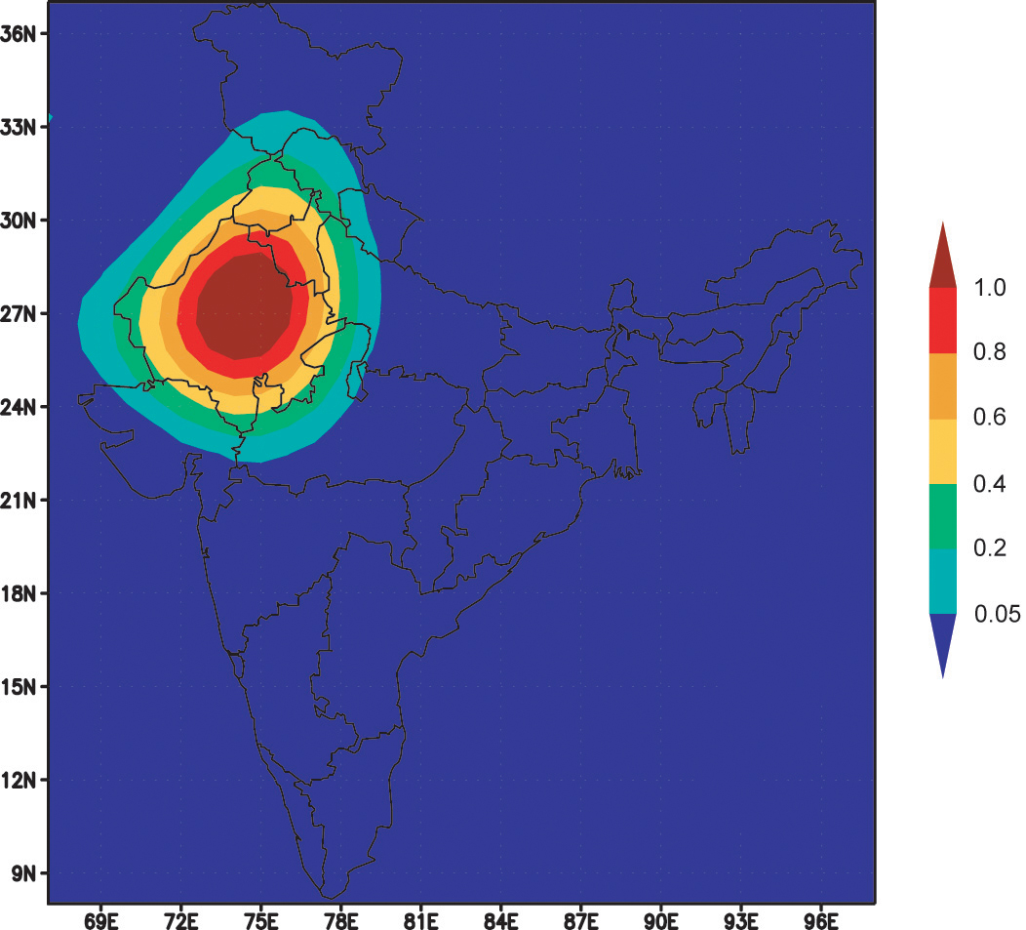
Groundwater depletion
Observations of India between 2002 and 2008 indicate significant depletion of groundwater resources for agriculture
Dramatic future problems are likely
http://www.nasa.gov/topics/earth/features/india_water.html

Slide 17
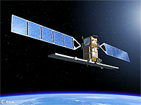
GMES
SENTINEL 1
Imaging radar mission at C-band to provide continuous all-weather imagery for:
Monitoring sea ice zones and the arctic environment, and surveillance of marine environment
Monitoring land surface motion risks
mapping of land surfaces: forest, water and soil
Mapping in support of humanitarian aid in crisis situations
Launch in 2013.

Slide 18
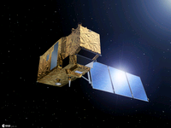
GMES
SENTINEL 2
A multi-spectral Earth observation system, allowing continuation of Landsat- and SPOT-type observations for:
Land cover, usage and change-detection maps
Risk mapping
Fast images for disaster relief
Launch in later 2013

Slide 19
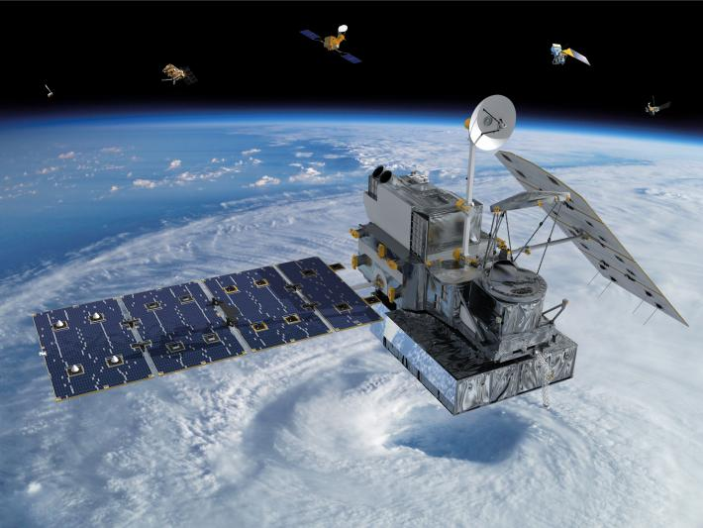
GLOBAL PRECIPITATION MEASUREMENT
Tropical Rainfall Measurement Mission (TRMM) showed potential for rainfall measurement
To provide global ~ 3 hour sampling 90% of the time would require a constellation of satellites
GPM Core Observatory is designed to serve as a calibration reference for the constellation
A joint NASA – JAXA mission with launch in June 2014
http://pmm.nasa.gov/GPM
Notes:
Scheduled launch mid-2014

Slide 20
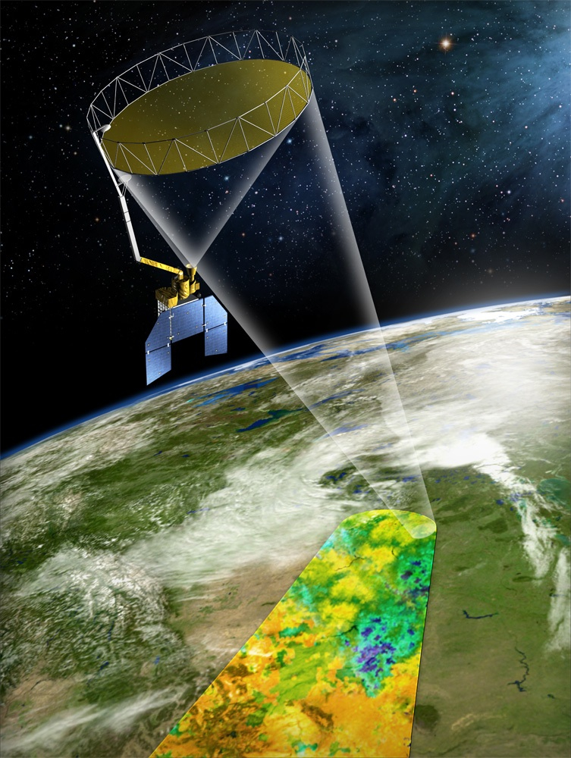
SOIL MOISTURE
ACTIVE PASSIVE
SMAP intended to measure soil moisture (upper 5cm) and freeze-thaw state
Uses an L band radar (active) and L band radiometer (passive)
Will have ~ 9km resolution with coverage every 3-4 days
Novel set of “early adopters” developed, including global crop and food security monitoring
Launch in October 2014
http://smap.jpl.nasa.gov
Notes:
Scheduled launch 2014

Slide 21
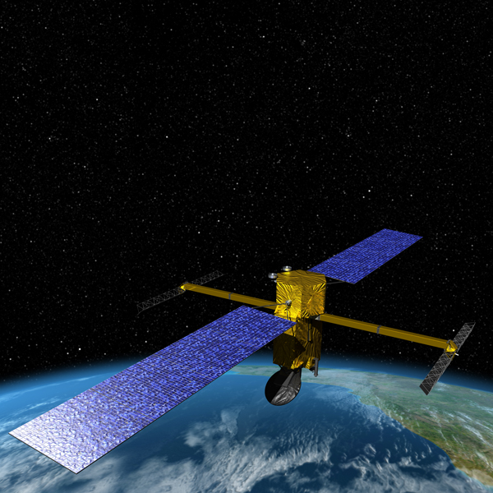
SURFACE WATER AND OCEAN TOPOGRAPHY
Space-borne sea surface radar altimeters are used to characterize sea state and motion
Also successfully used to monitor reservoir heights (e.g. Jason), but resolution is relatively low (2-10km), and there are gaps in coverage
SWOT Ka band radar interferometer will provide complete submonthly coverage at 100m
Launch in 2020
http://swot.jpl.nasa.gov/

Slide 22
Challenges:
New Sources and Uses of Ground Data

Slide 23
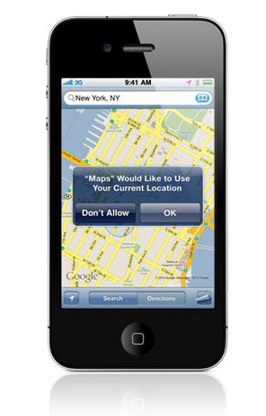
Mobile Technologies
Cell phones:
  Used by farmers to to query market prices and receive forecasts
  Used by food security practitioners to collect market prices
Smart phones:
  Emerging as critical survey tool to locate and document

Slide 24
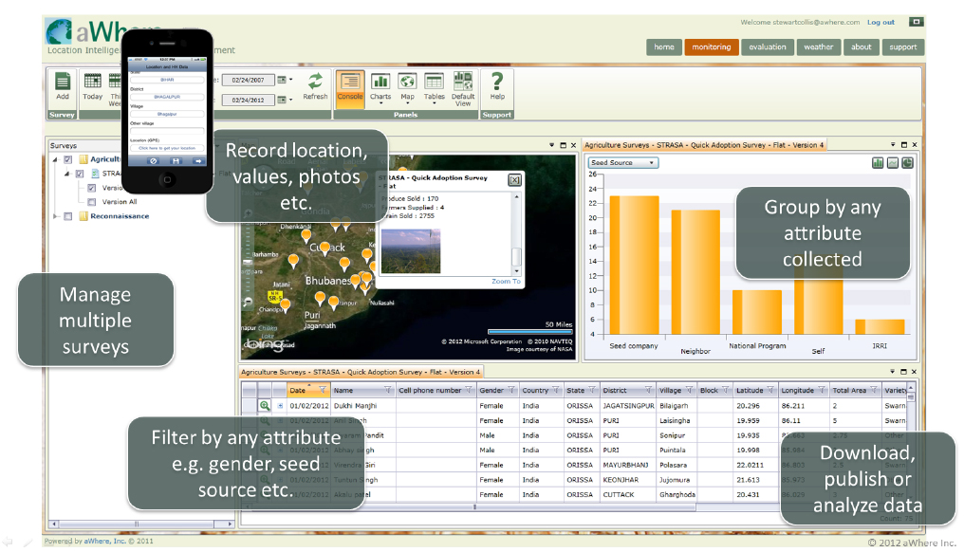

Slide 25
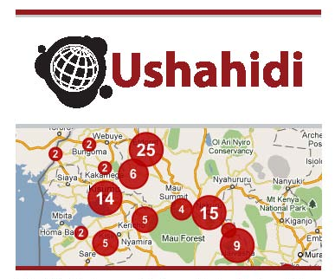
Crowd-sourcing
Ushahidi was developed in Kenya to track political violence in 2008
It has since been deployed in other emergencies to help direct relief efforts
Potential for use in larger emergencies is being explored
http://ushahidi.com/

Slide 26
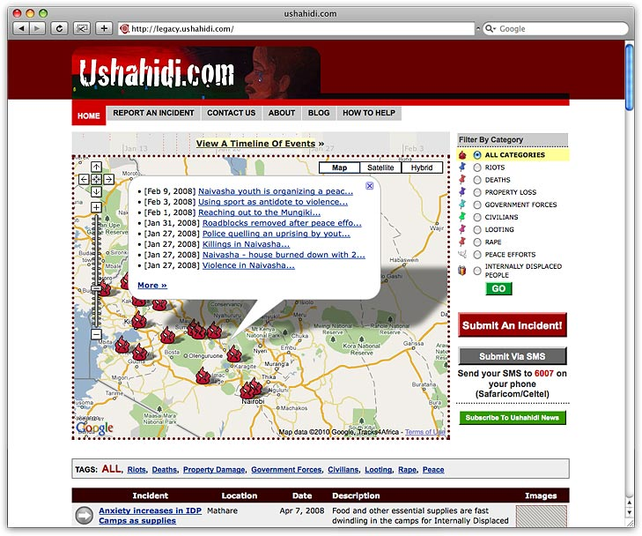

Slide 27
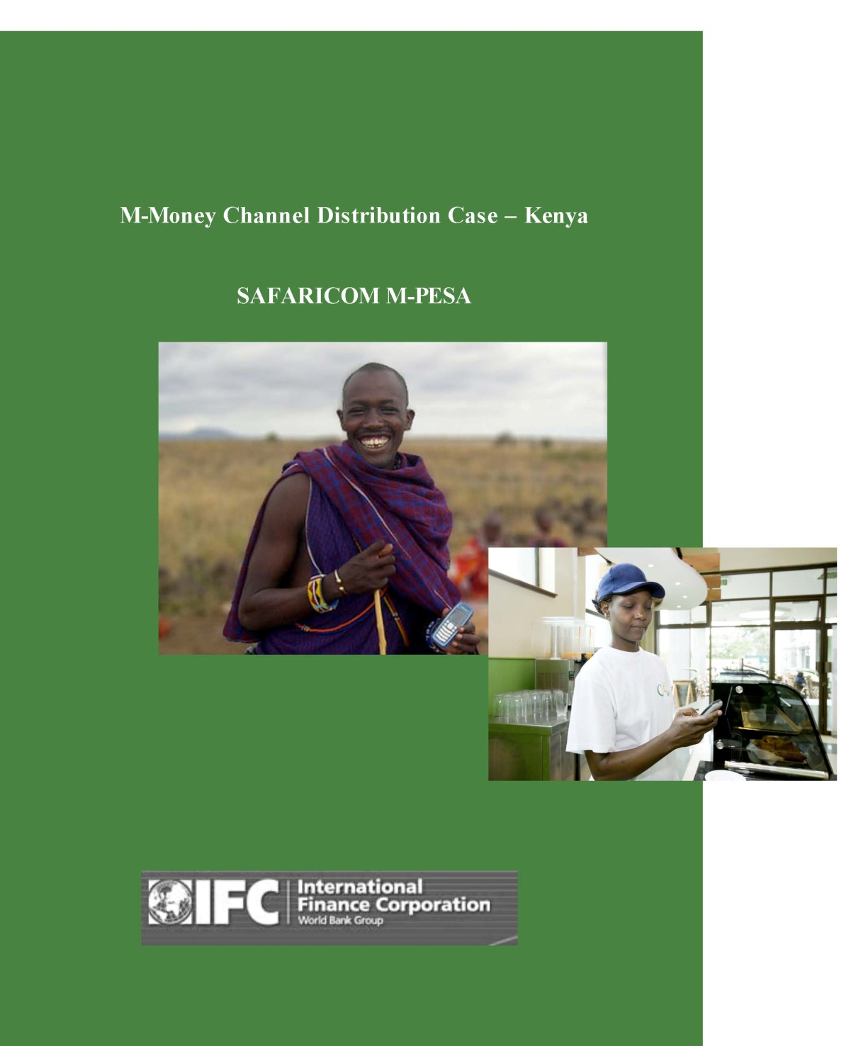
Mobile Money
Very few rural people in developing countries have bank accounts, but many have mobile telephones
Vodafone and Safaricom (Kenyan telecom company) developed a system (M-PESA) for basic mobile phones that allows users to:
  Deposit and withdraw money
  Transfer money to other users and non-users
  Pay bills
May be used to track the flow of money (remittances) to monitor potential problem areas
May also be an intervention tool
http://enterprise.vodafone.com/products_solutions/finance_solutions/m-pesa.jsp

Slide 28
The Need for Coordination
There are currently four systems for global agricultural monitoring using comparable approaches and data sets
  Foreign Agriculture Service Crop Explorer (USDA)
  Monitoring of Agriculture with Remote Sensing (EU)
  CropWatch (CAS)
  Global Information and Early Warning System (FAO)
There is a need to understand the ways in which new data can be assimilated in these systems.

Slide 29
GEO: A Means for Coordination
GEO established the Global Agricultural Monitoring Task and Community of Practice (GEO-GLAM; 2007) to develop:
  Articulation of requirements
  A common database to allow comparison of estimates
  A series of regional workshop to share methods and findings
  Joint Experiment for Crop Assessment and Monitoring
GEO-GLAM Action Plan on Food Price Volatility Endorsed by G-20 (2011)

